Slide 1

MICROSOFT VISUAL STUDIO

Slide 2
What will be Discussed
What is Visual Studio
How to download and install

Slide 3
What is Microsoft Visual Studio
Microsoft Visual Studio is an Integrated Development Environment (IDE) from Microsoft. Visual Studio is the one-stop shop for all applications built on the .NET platform. One can develop, debug and run applications using Visual Studio.
Using this tool we can develop, build, compile, publish and run applications with the .NET framework. It also provides some features such as Editor , compiler and interpreters.

Slide 4
Download Visual Studio
Download Visual Studio Latest Version
In order to download visual studio, please visit the following Visual Studio download link
https://visualstudio.microsoft.com/downloads/

Slide 5
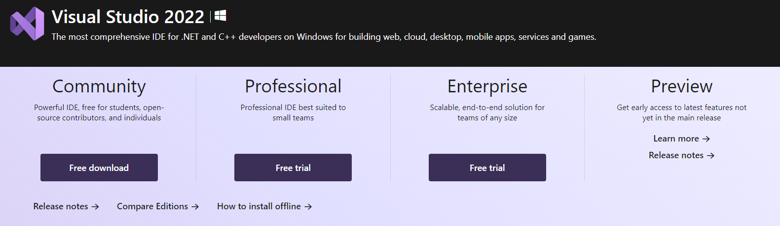
You can select :
Visual Studio 2022 Community Edition
Visual Studio 2022 Professional Edition (90-Day Free Trial)
Visual Studio 2022 Enterprise Edition (90-Day Free Trial)

Slide 6
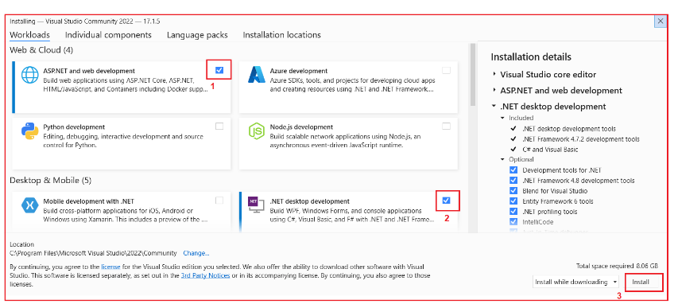

Slide 7
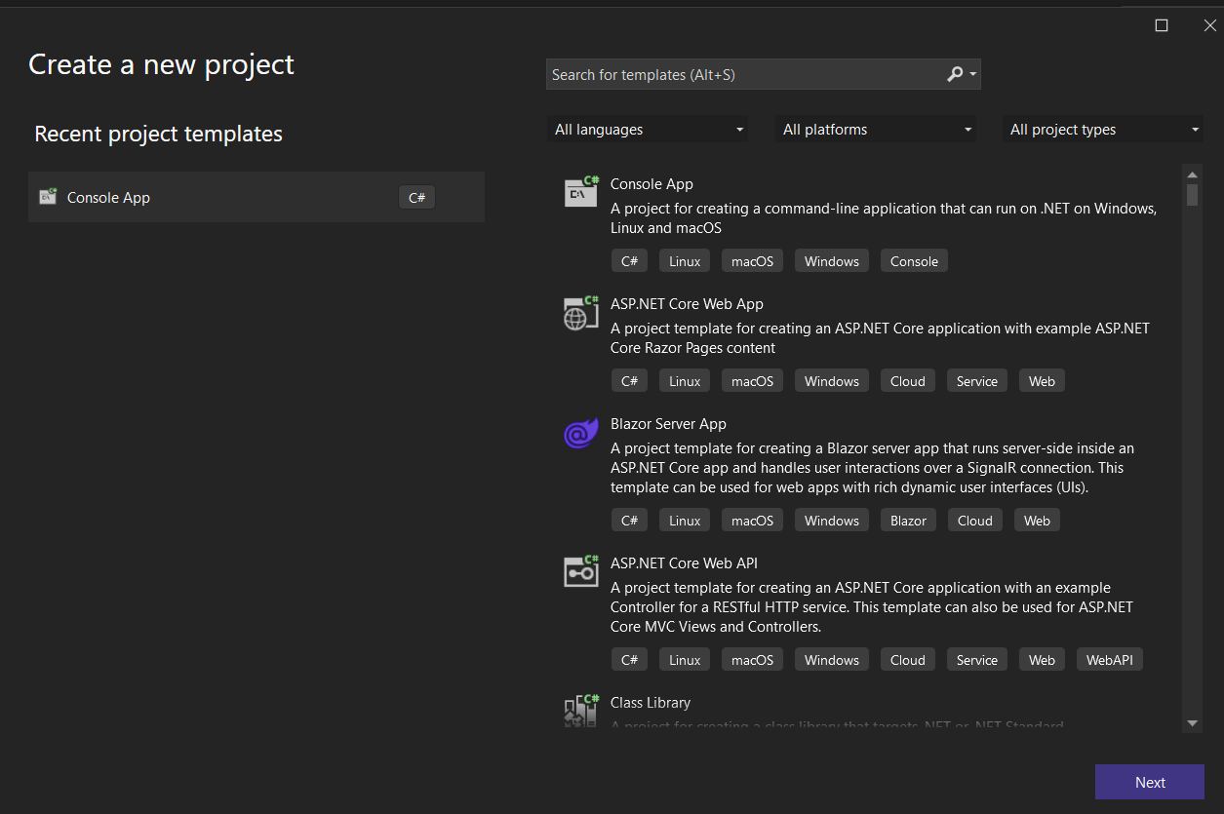
Creating the first console Application

Slide 8
What is a console Application
A console application is an application that can be run in the command prompt.
Console applications don’t provide ant GUI facilities like the mouse pointers , colors or buttons

Slide 9
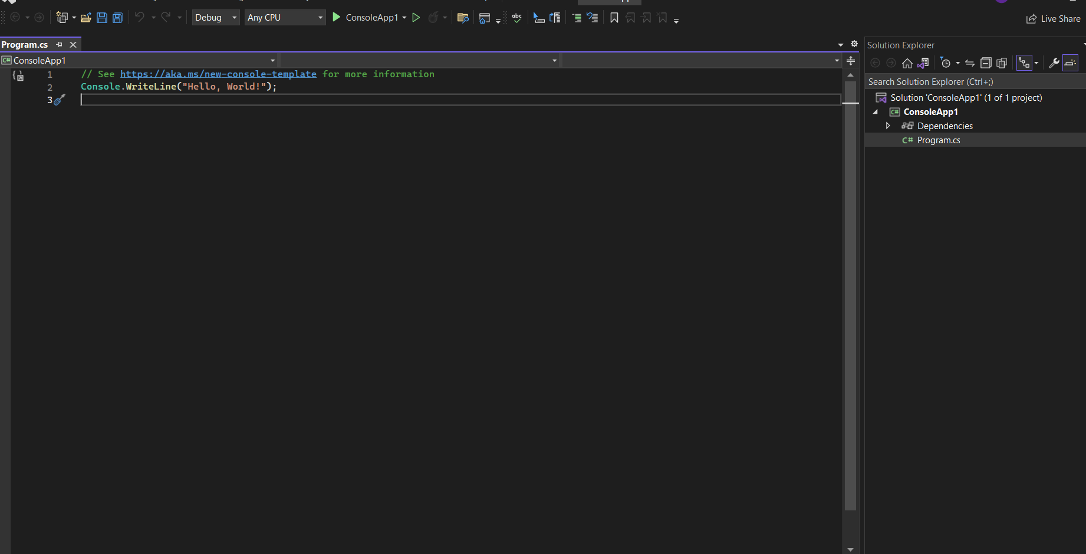
First Hello World

Slide 10
Installing Microsoft SDK
The .NET SDK (Software Development Kit) is a collection of tools, libraries, and runtime components that allow developers to build, test, and deploy .NET applications. The main purpose of the .NET SDK is to provide developers with a comprehensive and efficient development environment for creating .NET applications on Windows, macOS, and Linux platforms.
Some of the key features and capabilities of the .NET SDK include:
Compiler and language support: The .NET SDK includes compilers for several programming languages, including C#, F#, and Visual Basic. It also provides language-specific libraries and tools to support development in each of these languages.

Slide 11
Libraries and frameworks: The .NET SDK includes a large set of libraries and frameworks that developers can use to build applications with a variety of functionalities, including networking, cryptography, database access, web development, and more.
Build tools: The .NET SDK includes tools for building, packaging, and deploying .NET applications, including command-line utilities and graphical interfaces.
Runtime components: The .NET SDK includes the .NET runtime, which is responsible for executing .NET applications, and the .NET Standard Library, which provides a set of common APIs and interfaces that can be used across different .NET implementations.
Overall, the .NET SDK provides a powerful and flexible development platform for creating modern, high-performance applications on a wide range of platforms and devices.
To Download it visit: https://dotnet.microsoft.com/en-us/download

